Slide 1
BASIC ELECTRONICS (24B11EC111) UNIT-2 Lecture-7 (Clipper Circuits)

Slide 2
Outline
Content
Introduction to clippers
Classifications
Series clipper
Parallel clipper
Biased clipper
Examples
Combination clipper
Summary of clippers
Reference

Slide 3
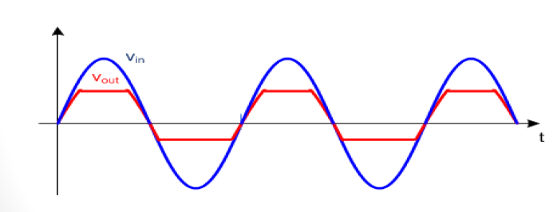
Introduction of clipper
Clippers are networks that employ diodes to “clip” away a portion of an input signal without distorting the remaining part of the applied waveform.
A circuit which use to remove the peak of the wave is called clipper.
Ref 1

Slide 4
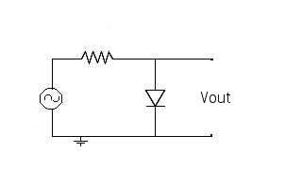
Why clipper used?
The purpose of clippers is to protect a circuit against too high or too low voltages.
A simplest clipper circuit →
V_{in}
Ref 1

Slide 5
Classification of clippers
According to non- linear devices used
Diode clippers and Transistor clippers
According to circuit configuration
Series clippers and Parallel clippers
According to biasing
Biased clippers and Unbiased clippers.
According to level of clipping
Positive clippers, Negative clippers and combination clippers
Ref 1

Slide 6
Series and Parallel clippers
D
If ,V_{i} < V_{d,} diode OFF, V₀=0
R.B
V_{i}
R
V₀
V_{i}
R
V₀
Series configuration
Ref 1

Slide 7
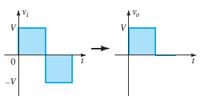
Series…
If, V_{i} > V_{d,} diode ON, V₀ = V_{i} -V_{d}
V_{d}
+ -
Where, V_{d}=0 V (for ideal diode)
V_{d}=0.7 V (practical diode or silicon diode)
F.B
R
V₀
V_{i}
Input and output waveform
Red line represent Practical diode and Blue line for Ideal diode

Slide 8
Parallel
Where R is extremely small
If ,V_{i} > V_{d,} positive half cycle
diode ON, V₀=V_{d}
R
D
V0
Vi
R
+
-
Vd
Vi
F.B
V0
Parallel configuration
Where, V_{d}=0 V (for ideal diode)
V_{d}=0.7 V (practical diode or silicon diode)
Ref 1

Slide 9
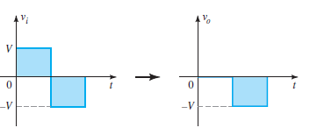
Parallel...
If ,V_{i} < V_{d,} for negative half cycle
diode OFF V₀= -V_{i}
R
D
V0
Vi
R.B
Input and output waveform
Red line represent Practical diode and Blue line for Ideal diode
Ref 1

Slide 10
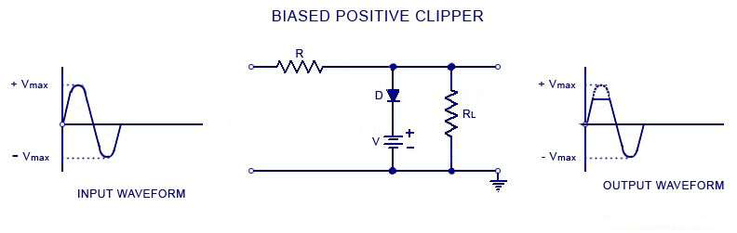
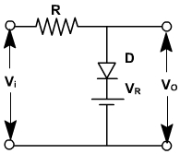
Biased positive clipper
When the input signal voltage is positive.
If V_{i} < V_{R}, diode is reversed biased and does not conduct. Therefore, V_{o} = V_{i}
If V_{i} > V_{R}, diode is forward biased and thus, V_{o}= V_{R}+V_{d}
Ref 1

Slide 11
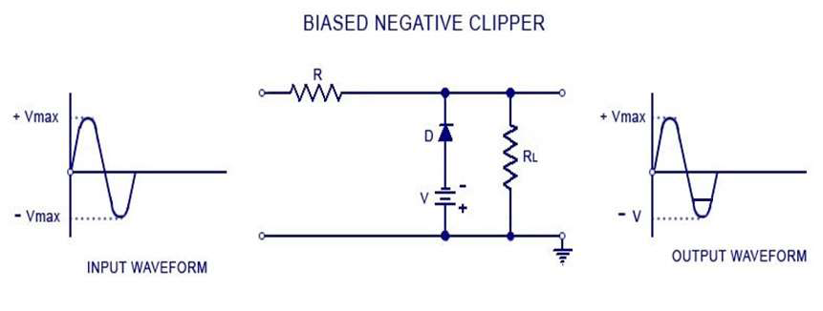
Biased negative clipper
When the input signal voltage is negative.
If |V_{i} |> |V_{R}| , diode is reversed biased and does not conduct. Therefore, V_{o} = -V_{i}
If |V_{i} |< |V_{R}| , diode is forward biased and thus, V_{o}= - V_{R}-V_{d}
V_{i}
V₀
V_{R}
Ref 1

Slide 12
Biased series clippers
D
D
+ -
+ -
R.B
V_{R}
V_{R}
V_{i}
R
V0
V_{i}<V_{R} + V_{d}
R
V₀=o
i
Fig. 1
Fig. 2
Ref 1

Slide 13
The output voltage by applying KVL
V₀=V_{i}-V_{R}-V_{d}
F.B
+ -
V_{d}
V_{R}
V_{i}>V_{R} + V_{d}
R
V₀
KVL
V_{i}
V_{o}
V_{m}
V_{m} –V_{R} -V_{d}
Diode on
V_{R} + V_{d}
T/2
T
T/2
T
Diode off
V_{R} + V_{d}
diode change the state

Slide 14
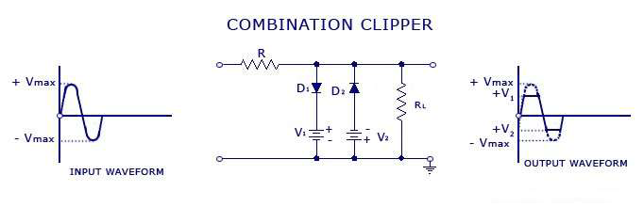
Combination (positive and negative) clipper
When a portion of both positive and negative of each half cycle of the input voltage is to be clipped (or removed), combination clipper is employed.
The circuit for such a clipper is shown in below fig.
Ref 1

Slide 15
Combination clipper…
During the positive half cycle, the diode D₁ is forward biased by the input supply voltage V_{i} and reverse biased by the reference voltage V₁. On the other hand, the diode D₂ is reverse biased by both input supply voltage V_{i} and reference voltage V₂
if Vi<V1, V0=Vi , D1 and D2 off
If Vi>V1, Vo=V1, D1 on and D2 off
During the negative half cycle, the diode D1 is reverse biased by both input supply voltage Vi and reference voltage V1. On the other hand, the diode D2 is forward biased by the input supply voltage Vi and reverse biased by the reference voltage V2.
if Vi<V2, V0= -Vi , D1 and D2 off
If Vi>V2, Vo=V1, D1 off and D2 on
Ref 1

Slide 16
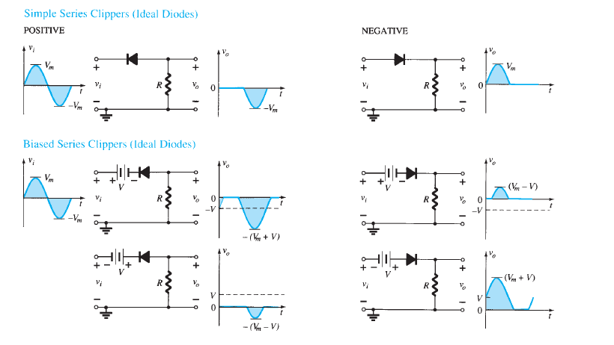
Summary of clippers
Ref 1

Slide 17
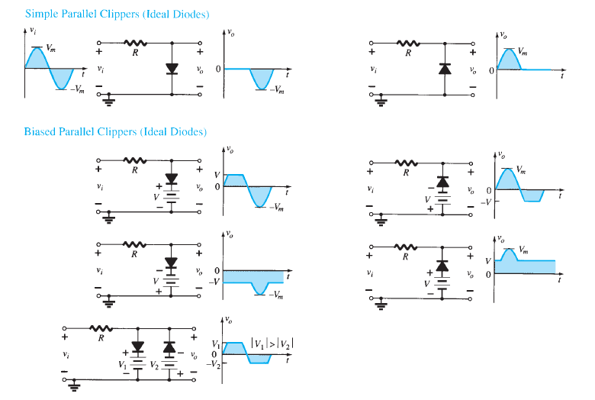

Slide 18
References
[1] R. Boylestad and L. Nashelsky, ‘Electronic Devices and Circuit Theory’, PHI, 7e, 2001.

